Slide 1
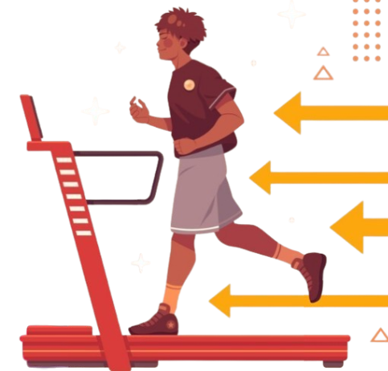
Machine Learning Model On Calories Burned Prediction
By : Roopam Ambekar

Slide 2












Objective
Approach
Model Summary
Results
Inference
Reference & Comments
Problem Statement
Stakeholders
Business Use Case
Predict the number of calories burned during physical activities based on individual and activity-related features.
The model is a regression problem and uses features like:
Gender
Age
Height
Weight
Duration of exercise
Heart rate
Body temperature
The goal is to provide an accurate calorie burn estimate using machine learning.
Healthcare & Fitness Companies: Interested in personalized fitness plans.
Gyms & Personal Trainers: To optimize client routines based on calorie expenditure.
Wearable Tech Manufacturers: For real-time calorie tracking and analytics.
End Users / Individuals: For health monitoring and weight management.
Nutritionists & Dietitians: For tailoring diet plans based on activity data.
Fitness Platforms: Provide personalized workout recommendations based on predicted calorie burn.
Insurance Companies: Incentivize active behavior via dynamic premiums based on exercise levels.
Health Apps: Deliver accurate insights into energy expenditure to motivate healthy habits.
Wearables: Improve prediction algorithms for better tracking accuracy and user trust.

Slide 3
Objective
Approach
Model Summary
Results
Inference
Reference & Comments
Data Preparation
Train Baseline Model
Further Models & Model Evaluation
Preprocess the data by handling missing values, removing duplicates, and resolving any inconsistencies.
Perform univariate analysis to determine which features exhibit the strongest correlation with the target variable.
Build a baseline linear regression model to evaluate its performance.
Build a baseline random forest model for comparison with the linear regression model.
Build and evaluate Random Forest, Gradient Boosting, and LGBM models.
Use Grid Search CV to find the optimal hyperparameters and the best-performing model.
Make predictions using the best model.

Slide 4
Objective
Approach
Model Summary
Results
Inference
Reference & Comments
Data Points
Data Cleaning and EDA
Description | Count
Data | 15,000
Train Data | 12,000
Test Data | 3,000
Data Cleaning
Removed unnecessary columns like Unique_ID, as it likely represents an identifier with no predictive value, and keeping it could lead to overfitting or unnecessary computational complexity.
EDA
Looked in to the correlation of different features to the target value and plotted a bar graph for visualization
Models used in Grid Search CV
Machine Learning Models & Metrics
Model Name | Hyperparameters in Grid Search CV
Random Forest | n_estimators = 100 max_depth = 20
XGBoost | n_estimators = 100 max_dept = 20 learning_rate = 0.1
LGBM | n_estimators = 100 max_depth = 20 learning_rate = 0.1
KNN | n_neighbors = 5 weights = “uniform’
Averaging Ensemble Model | XGBoost – n_estimators – 100, max_depth – 20, learning rate – 0.1 LGBM - n_estimators – 200, max_depth – 20, learning rate – 0.1
Models used -
Linear Regression
Random Forest
XGBoost
LGBM
KNN
Metrics used -
Mean Absolute Error
R2 score

Slide 5
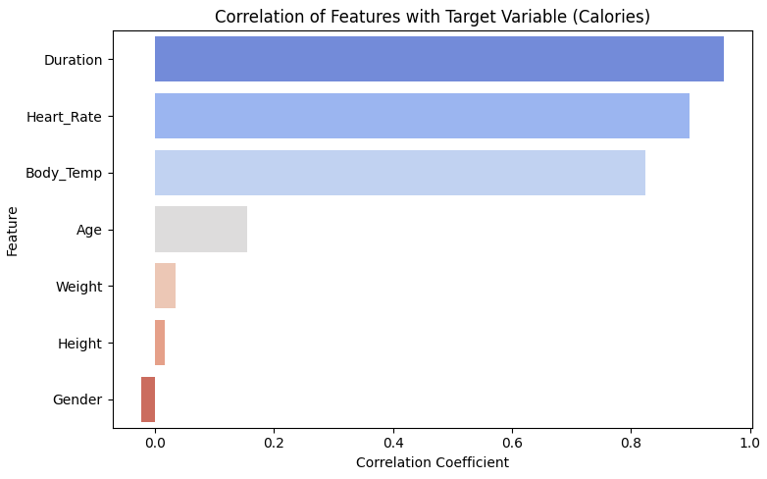
Objective
Approach
Model Summary
Results
Inference
Reference & Comments
Data Cleaning and EDA
Correlation of features with 'Calories'
Duration = 0.955421
Heart_Rate = 0.897882
Body_Temp = 0.824558
Age = 0.154395
Weight = 0.035481
Height = 0.017537
Gender = -0.022357

Slide 6
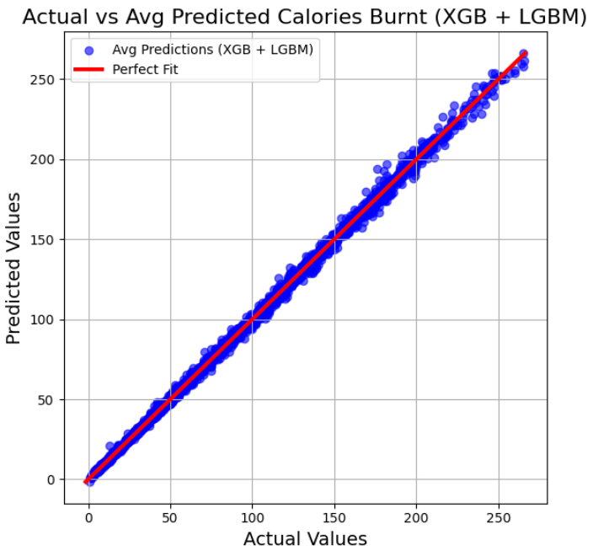
Objective
Approach
Model Summary
Results
Inference
Reference & Comments
Model Performance
Actual vs Predicted Values
 | Model Name | MAE |  | R2 Score
 |  | Train | Test | Train | Test
Baseline Model | Linear Regression | 8.39 Cal | 8.21 Cal | 0.967 | 0.968
 | Random Forest | 0.69 Cal | 1.81 Cal | 0.999 | 0.998
Gris Search CV | LGBM | 1.01 Cal | 1.57 Cal | 0.999 | 0.999
 | XGBoost | 0.00 Cal | 2.23Cal | 1.000 | 0.997
 | KNN | 4.25 Cal | 5.03 Cal | 0.990 | 0.987
Ensemble Model | Averaging of XGBoost & LGBM | 0.50 Cal | 1.47 Cal | 0.999 | 0.998
Hyperparameters of LGBM
learning_rate – 0.1 max_depth – 20 n_estimators – 200
Hyperparameters of XGBoost
learning_rate – 0.1 max_depth – 20 n_estimators – 100

Slide 7
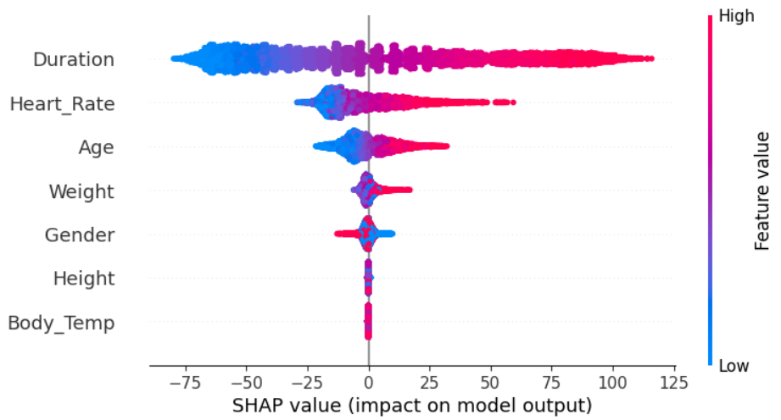
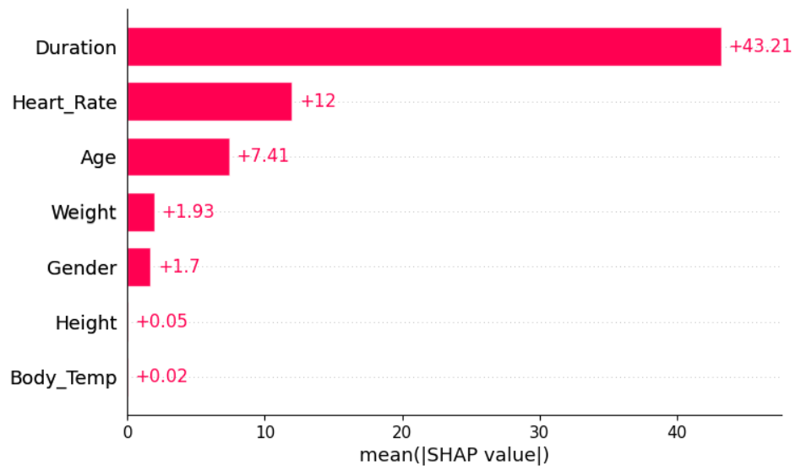
Objective
Approach
Model Summary
Results
Inference
Reference & Comments
Shapely Summary Plot of Features
Feature Importance – Bar Plot

Slide 8
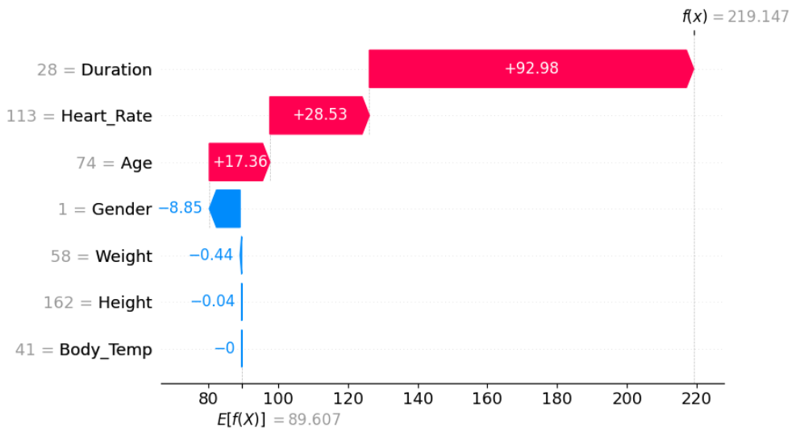
Objective
Approach
Model Summary
Results
Inference
Reference & Comments
Impact on Features on Final Output for 1 Instance
Model Prediction
Gender (0 for Male, 1 for Female): 0
Age: 68
Height (in cm): 190
Weight (in kg): 94
Exercise Duration (in minutes): 29
Heart Rate: 105
Body Temperature (in °C): 40.8
Actual Calories Burned = 231.0 Cal
Predicted Calories Burned = 231.55 Cal
Baseline 𝐸[𝑓(𝑋)]=89.607
Final prediction 𝑓(𝑥)=219.147

Slide 9
Objective
Approach
Model Summary
Results
Inference
Reference & Comments
REFERENCES
Code & Dataset Link : https://github.com/Roopam-Ambekar/IIT_Roorkee_CloudxLab_-Capstone_Project_Calories_Burned_Prediction Dataset source: https://www.kaggle.com/datasets/fmendes/fmendesdat263xdemos Hands-On Machine Learning with Scikit-Learn, Keras, and Tensorflow - Aurelien Geron Chen, T., & Guestrin, C. (2016). XGBoost: A Scalable Tree Boosting System. In Proceedings of the 22nd ACM SIGKDD International Conference on Knowledge Discovery and Data Mining (pp. 785– 794) LightGBM: A Highly Efficient Gradient Boosting Decision Tree Ensemble Methods: Foundations and Algorithms
REFERENCES
COMMENTS ON NEXT STEPS
Optuna for Hyperparameter Tuning: Use Optuna to optimize the hyperparameter space more efficiently than Grid Search CV Leverage techniques like Bayesian Optimization and early pruning of unpromising trials Deployment and Monitoring Use frameworks like Flask, FastAPI, or Django to expose the model as an API. Implement monitoring tools to track prediction accuracy and latency after deployment.

